Slide 1


Welcome to the 105th ASM Annual Meeting:
Awards Ceremony
Marriott 4th Floor Ballroom III

Slide 2
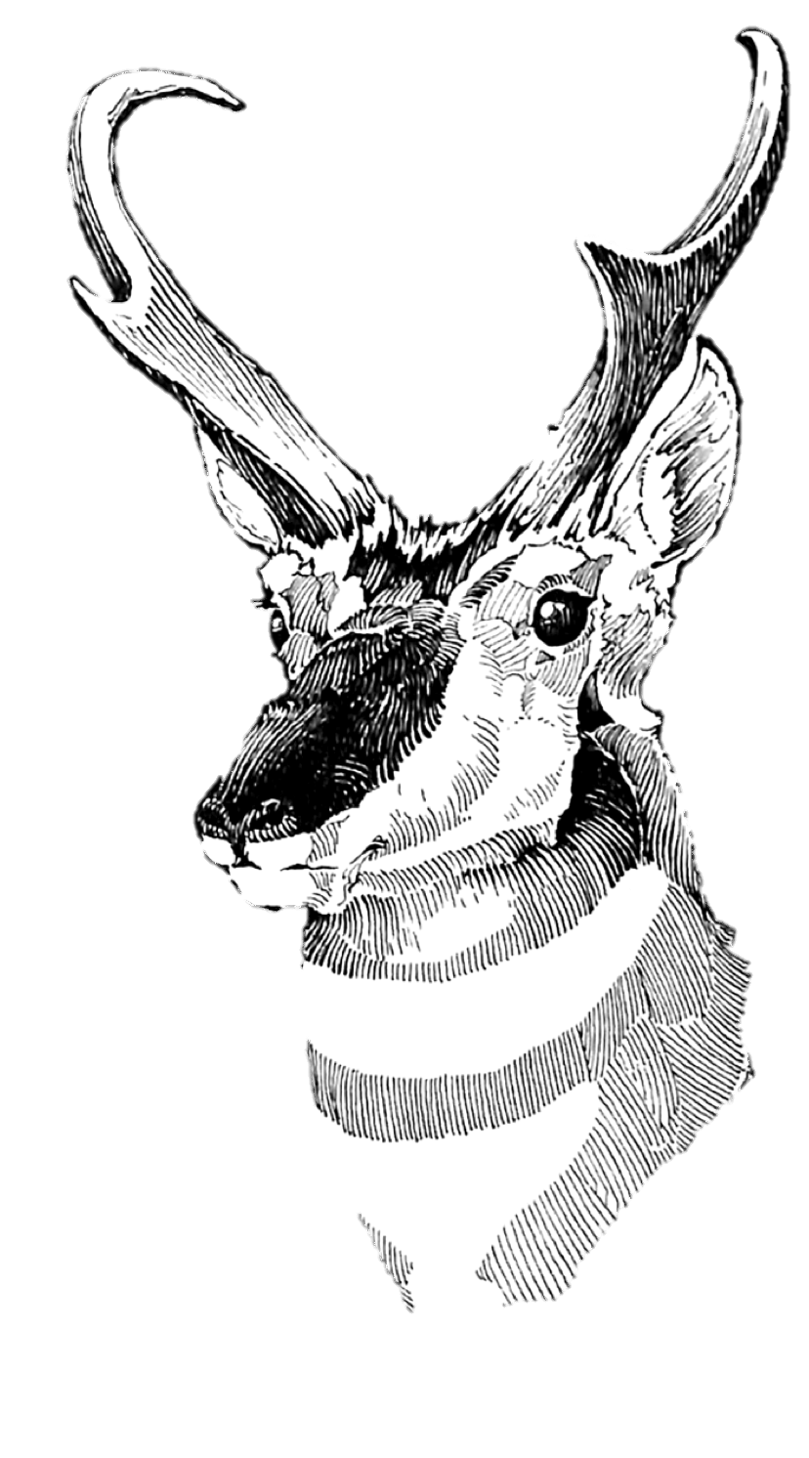
Past President
Tribute
Felisa Smith

Slide 3
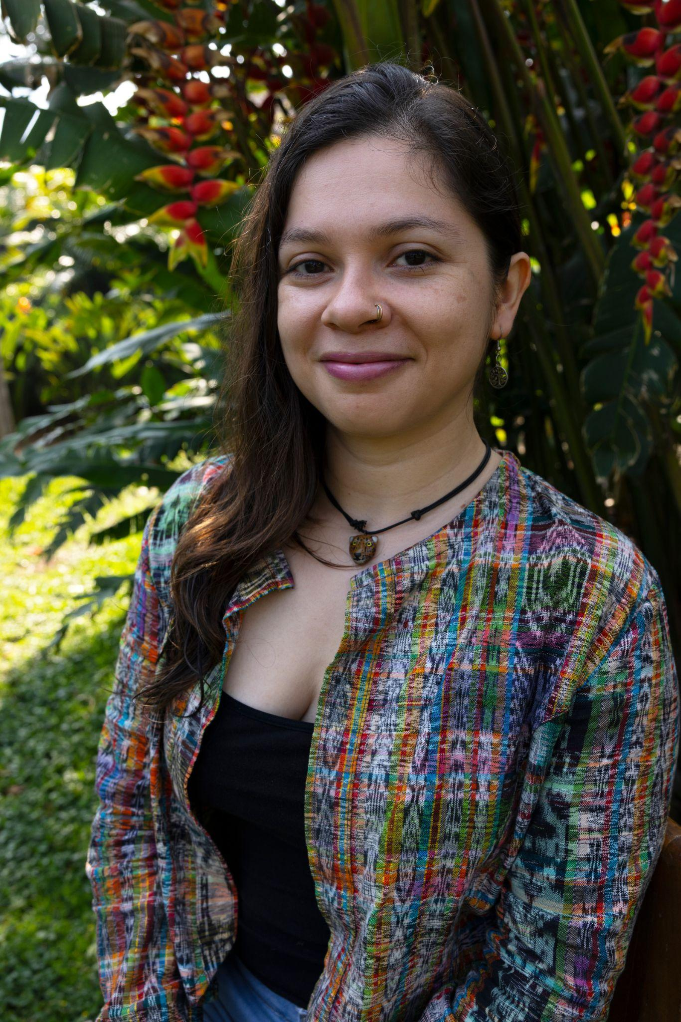
2026 ASM International Travel Awards
Bárbara Escobar Anleu, Centro Agronómico Tropical de Investigación y Enseñanza, Guatemala
Catalina Tomé,
Chair
International Relations Committee

Slide 4
2026
African Research Fellowships
Jesse Alston
Marissa Dyck, co-Chairs
Blessing Asianzu – Uganda, PhD – behavioral and disease ecology of chimpanzees
Tshiamo Baisang – ­Botswana, MPhil – ecology of aardvarks
Armel Batchi-Bouyou – Congo-Brazzaville, MSc – conservation of small mammals
Abdirisak Ibrahim – Somalia, MSc – conservation of Speke’s gazelle
Omar Machich – Morocco, PhD – conservation of the African golden wolf
Nelly Maiyo – Kenya, MSc – invasion ecology of big-headed ants and lions
Mosia Rasekuwane – South Africa, PhD – ecology of Temminck’s pangolins
Kyra Van Rensburg – South Africa, PhD – conservation of small mammals
Notes:
Presented by … Jesse Alston

Slide 5
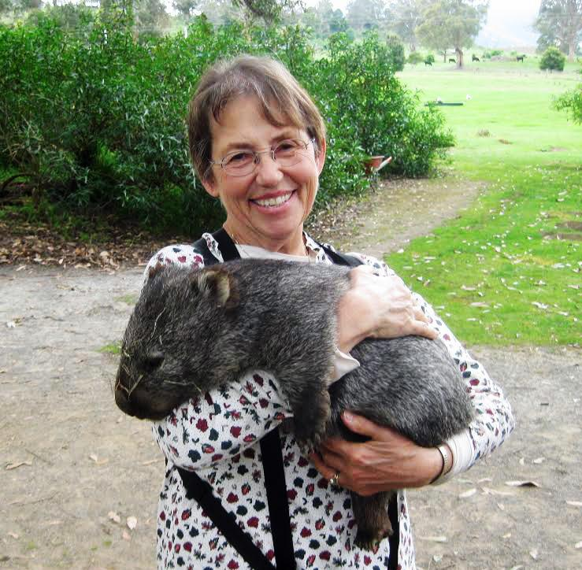
2026 Alicia V. Linzey Award
Megan Jones,
University of Pretoria
Digging Deeper: Predicting the Fate of Subterranean Mammals and their Ecosystem Services under Climate Change

Slide 6
2026 Latin American Student
Field Research Awards
Beatriz Dybas de Natividade (Brazil) . University of Illinois Chicago, USA
Hugo Eduardo Ferreira (Brazil). Federal University of Rio Grande do Norte (UFRN), Brazil
Gloria Lucia Sánchez Trejo (El Salvador). University of Oklahoma, USA
Miguel Fernando Cura (Argentina). Universidad Nacional de Córdoba (UNC), Argentina
Jennifer González Duve* (Uruguay). Universidad de la República, Uruguay
Pablo Gastón Carrizo (Argentina). Universidad Nacional de Tucumán, Argentina
All, Ph.D. students, except * (M.Sc.)
Sergio A. Solari,
Chair
(Nicté Ordoñez presenting)
Latin American Fellowship Committee

Slide 7
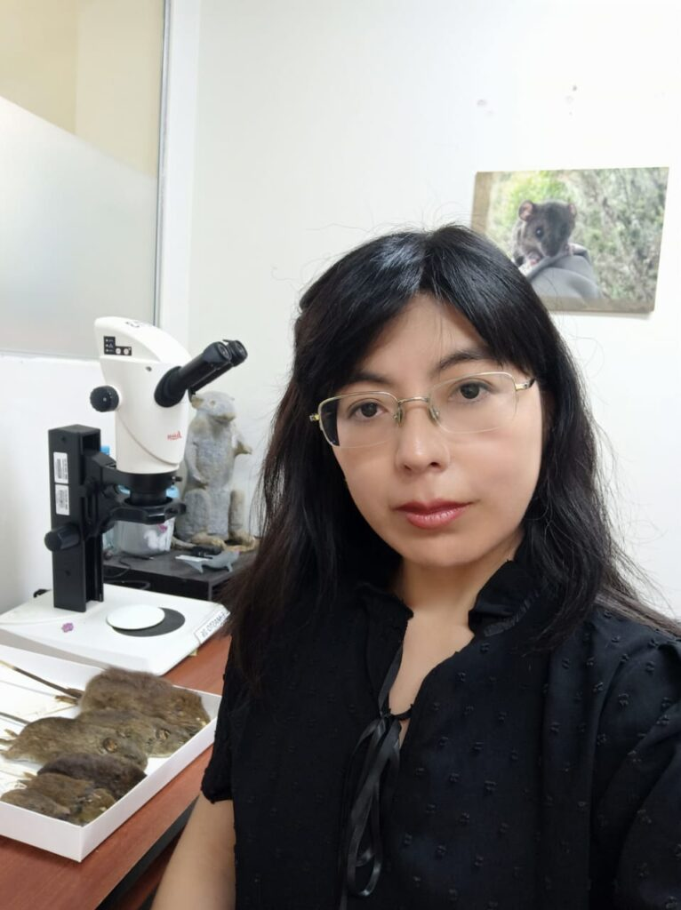
2026 Oliver P. Pearson Award
Dennisse Ruelas P. (Perú)
Assistant Professor at Universidad Nacional Mayor de San Marcos, and Curator (bats) in Museo de Historia Natural (MUSM)
Notes:
Nicté Ordóñez, Chair
Latin American Fellowship Committee

Slide 8
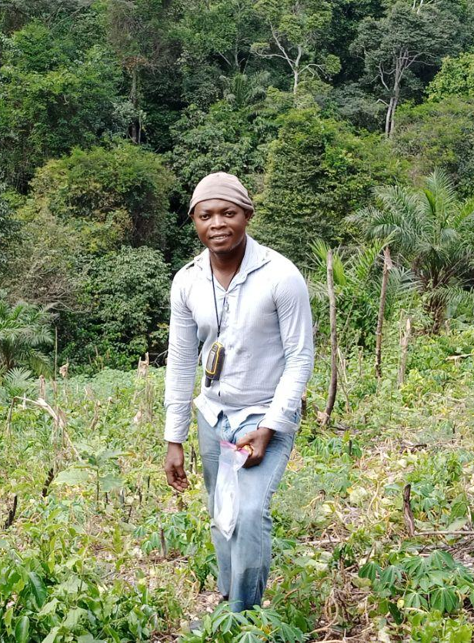
2026 James L. Patton Award
Amétépé Hounmavo
PhD student
University of Lomé
Lomé, Togo
Notes:
(THEY go by name Iris)

Slide 9
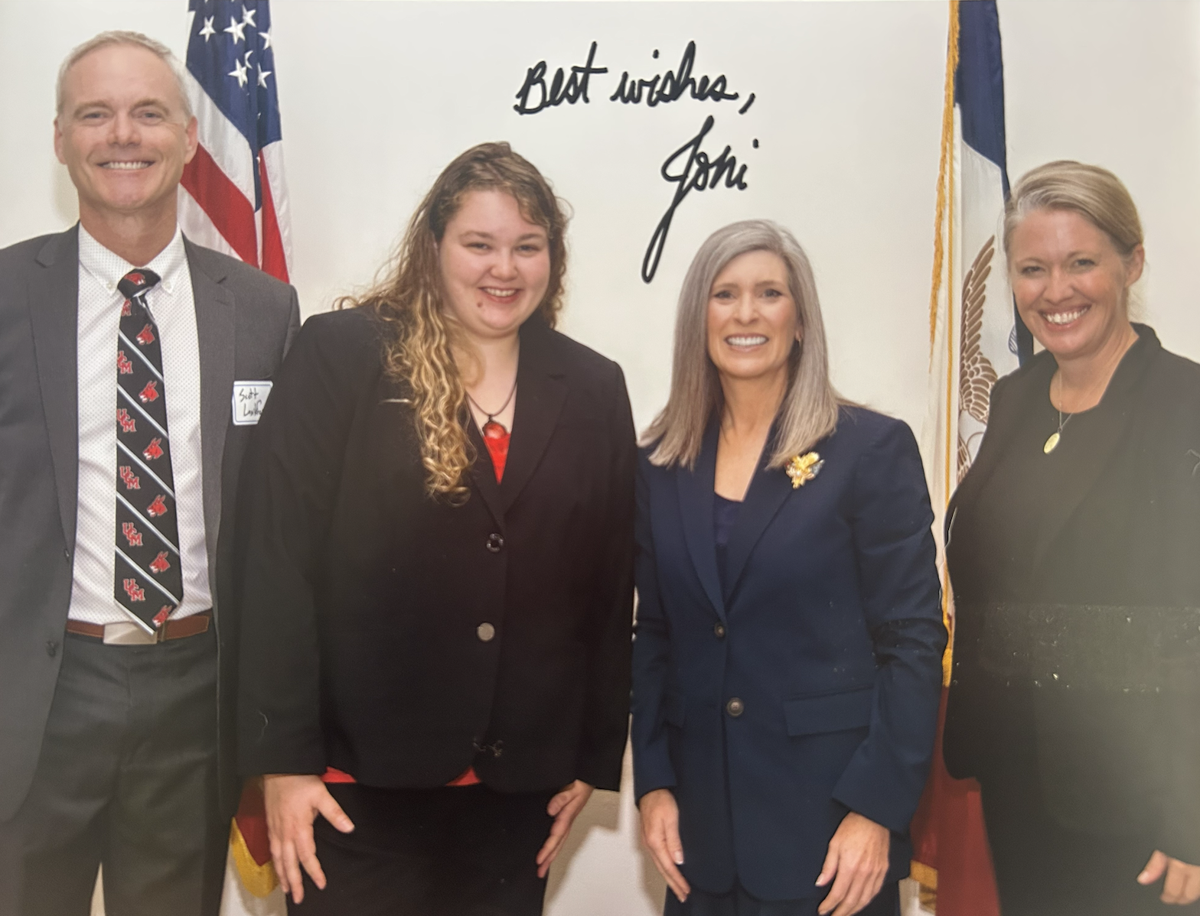
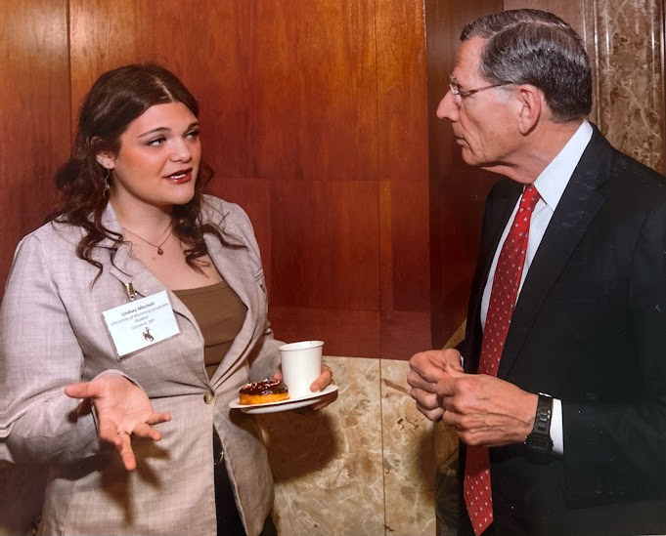
Student Science Policy Awards
Tayah Lande
Iowa State University
Lindsey Mitchell
University of Wyoming

Slide 10
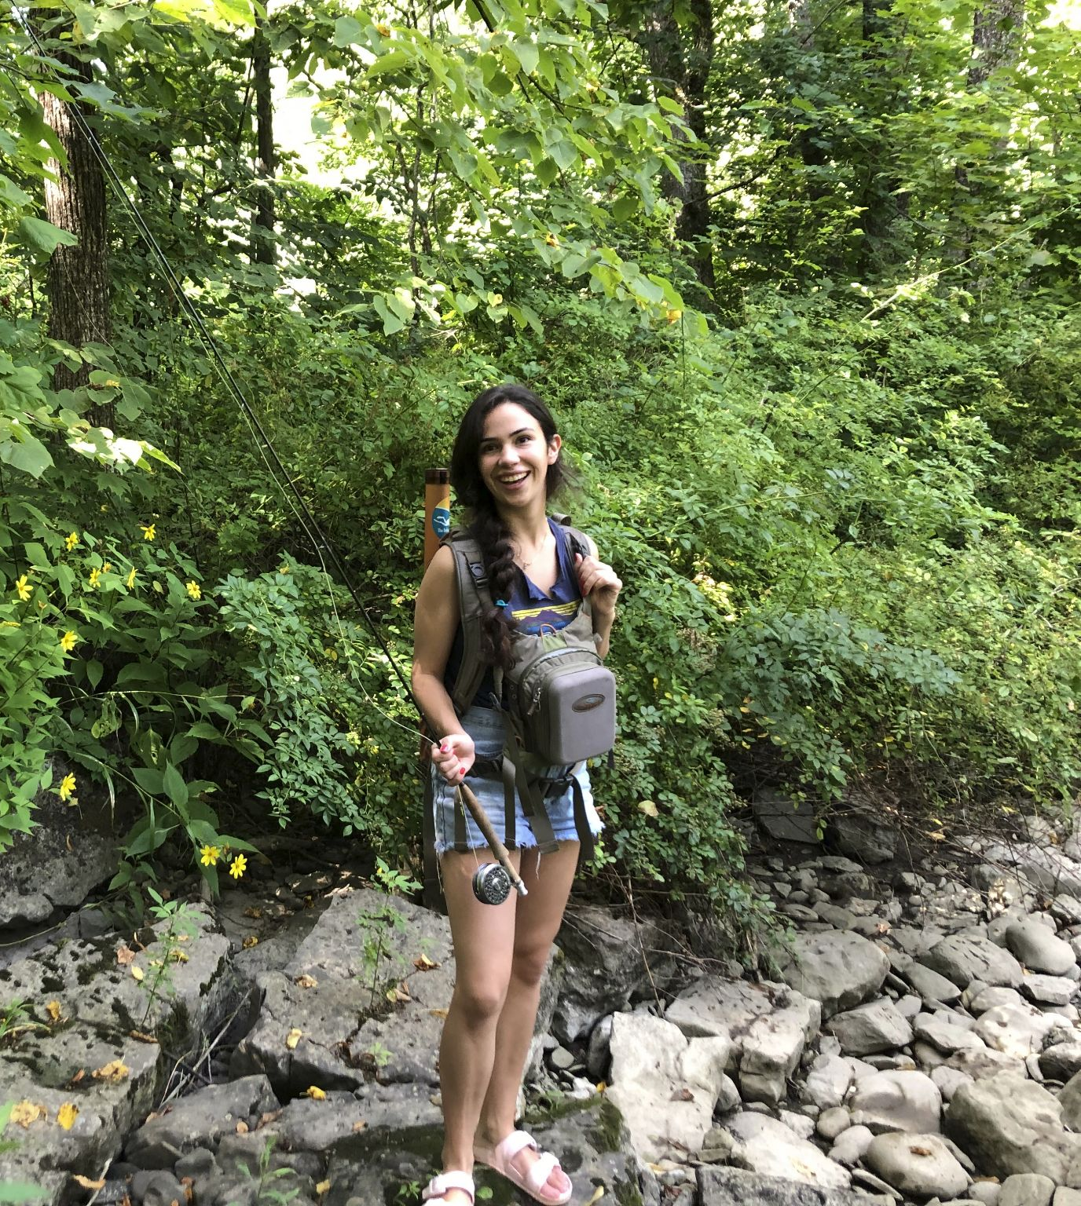
2026 Guy N. Cameron Award (Student)
Montana Stone, Department of Ecology, Evolution, and Organismal Biology
Brown University

Slide 11
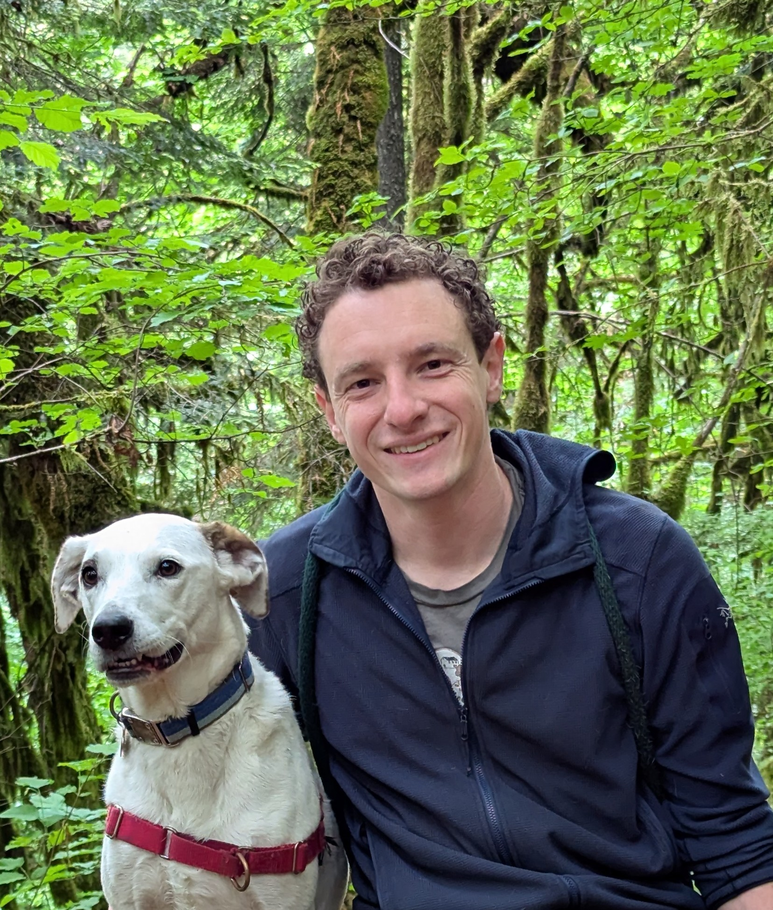
2026 Guy N. Cameron Award (Postdoc)
David Sneddon
Department of Integrative Biology
Oregon State University

Slide 12
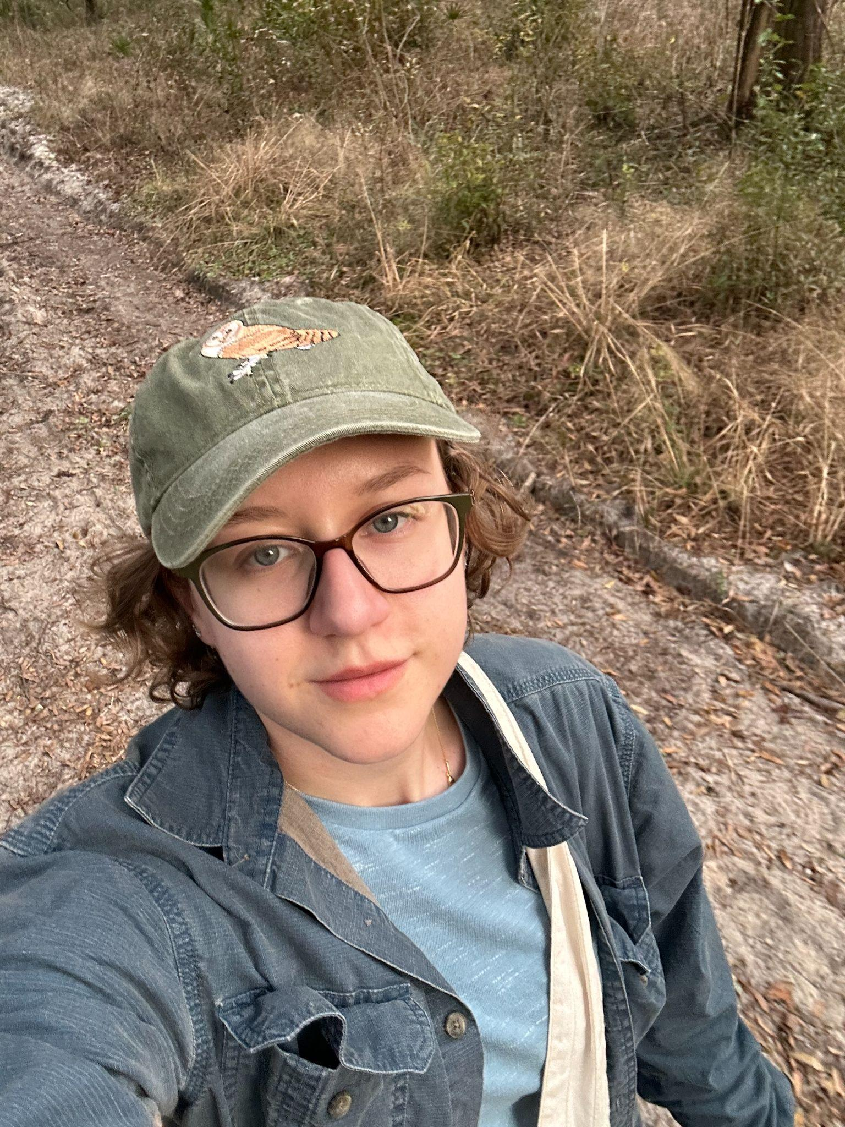
2026 Stephen Jenkins Scholarship in Mammalogy Award
Meg Holst
Florida Museum of Natural History & University of Florida

Slide 13
2026 Donald W. and Glennis A. Kaufman Award
Marissa Pitts
University of Oklahoma

Slide 14
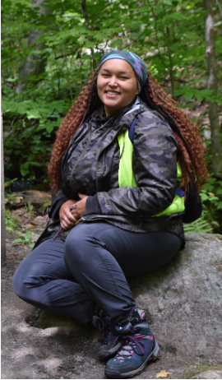
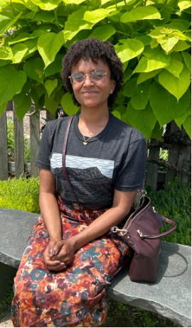
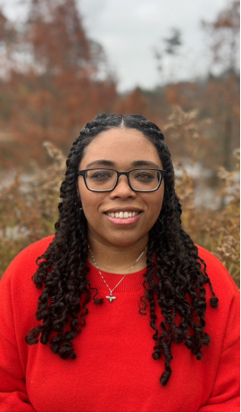
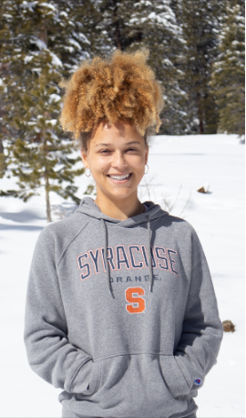
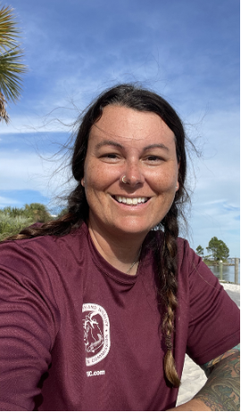





2026 Black & Indigenous Scholars Awards

Slide 15
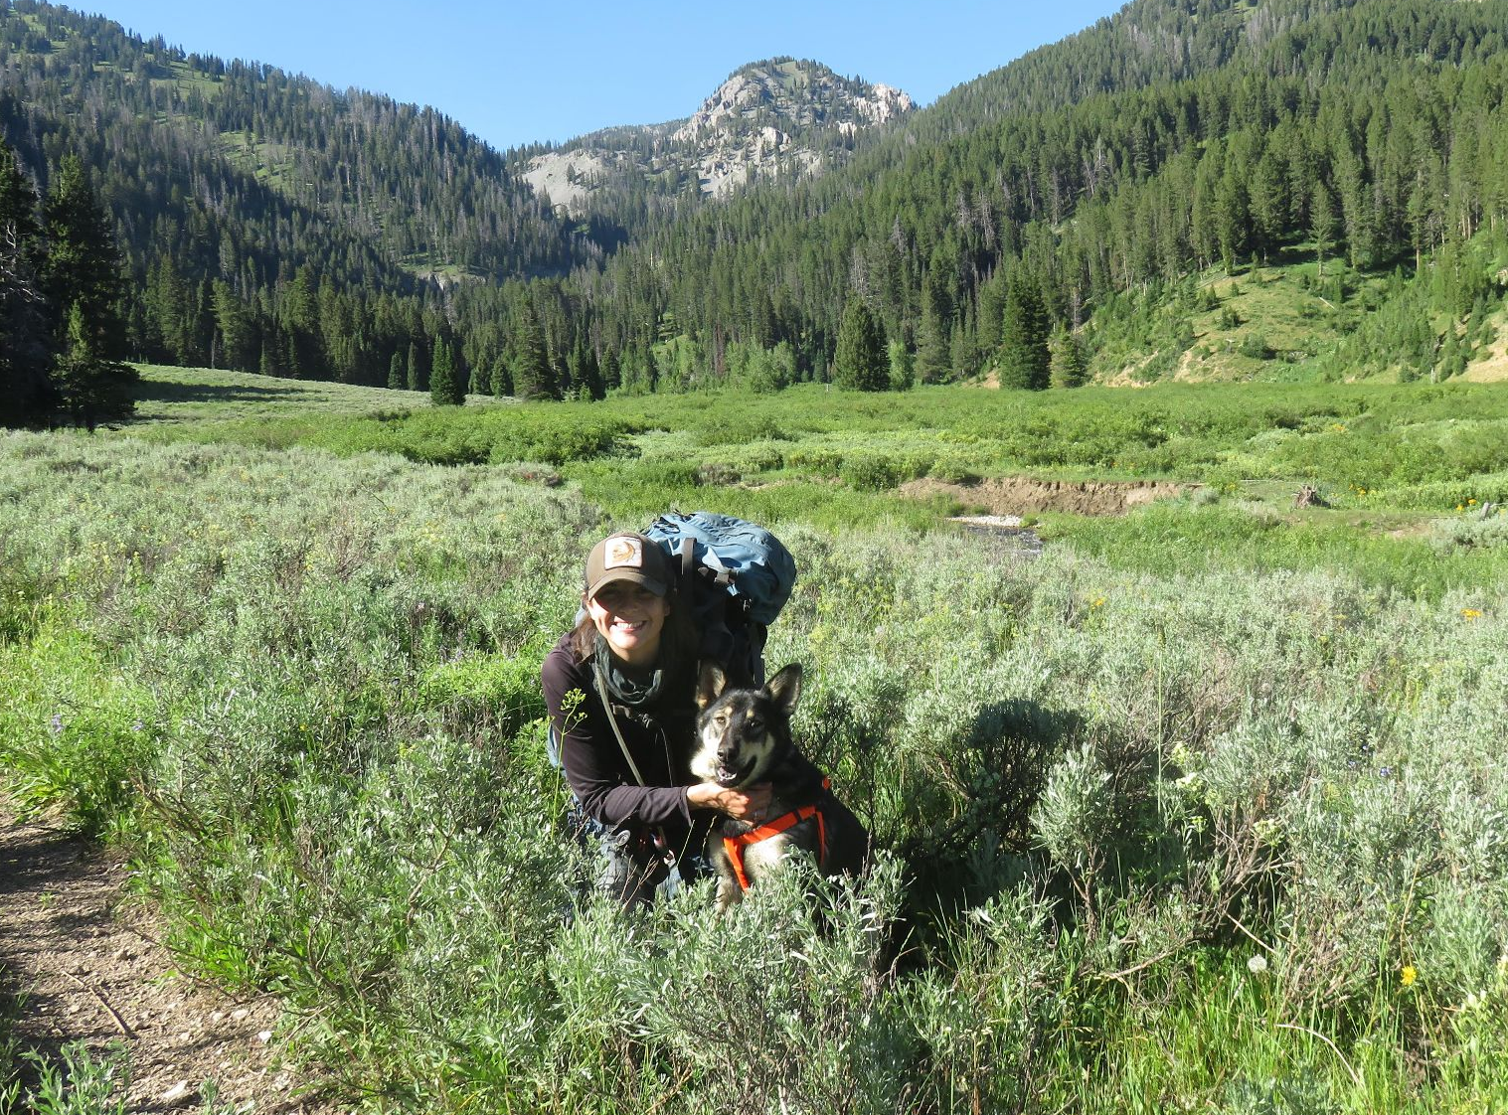
2026 J. Mary Taylor Award
Rhiannon Jakopak

Slide 16
2026 Rising Undergraduates in Mammalogy travel support
-
Chloe Lynn, University of Florida
Brooks Rogers, University of Florida
Daisy Hernandez, Chicago State University
Audrey Vanderhee, University of New Mexico
Sam’ya Orr, University of Florida
Caliope Sharp, University of Kansas
Laurie Dizney and
Tokay Alberts,
co-Chairs
IDEA committee
(presented by Alex Jensen)
Notes:
IDEA committee

Slide 17
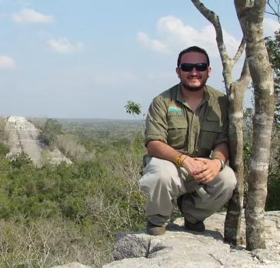
2026 Aldo Leopold Award
José González-Maya

Slide 18
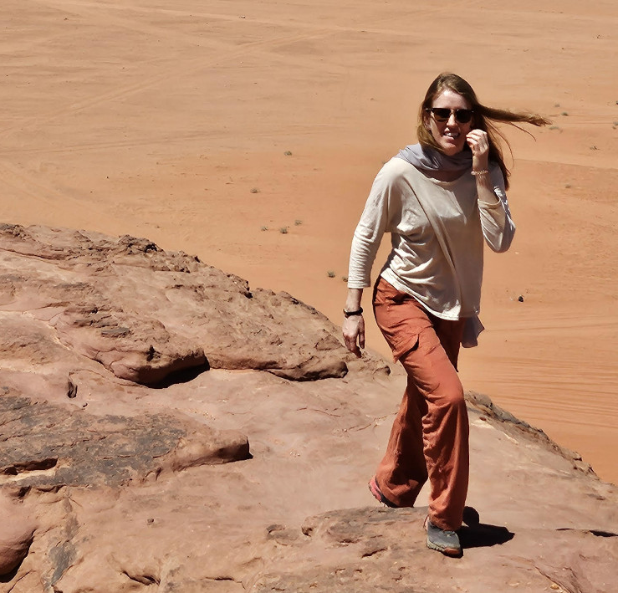
2026 Murie Family Conservation Award
April Martinig

Slide 19
2026 Outstanding Oral Presentation
Master’s Student
First Place
Joseph Gajewski
Runner-up
Patricia Schenke
Presented by:
Marissa Dyck
Program &
Education and Graduate Students committees

Slide 20
2026 Outstanding Oral Presentation
Doctoral Student
First Place
Kristin Stierman
Runner-up
Xi Zhao
Presented by:
Marissa Dyck
Program &
Education and Graduate Students committees

Slide 21
2026 Grants-in-Aid of Research
Binaya Adhikari University of Kentucky
Diana Alvarado Georgetown University
Manuel Arturo Quispe Lopez Texas Tech University
Ilaria Bacchiocchi University of Idaho
Emily Bache University of Pittsburgh
Duha Barkana University of Pittsburgh
Victoria Bartolome Universidade Federal do Rio de Janeiro
Brittany Bingham University of Oklahoma
Sebastian Bocio Universidad Autónoma de Santo Domingo
Annika Dean Georgetown University
Beatriz Dybas da Natividade University of Illinois Chicago
Mason Hintermeister Johns Hopkins School of Medicine
Audrey Hsi Stanford University
Nicholas Jaworski The University of Texas at Austin
Sony Lama East Tennessee State University
Scott Lindenberger East Tennessee State University
Megan McDaniels University of California Davis
Emilio Pedroza Lopez University of Rhode Island
Alexandra Sheldon University of Texas at San Antonio
Autumn Sims Tennessee Technological University
Charlotte Sue University of Colorado Boulder
Kaiden Sykes University of Cincinnati
Corrina Tapia Michigan State University
Wyatt Toure Columbia University
Tatiana Velásquez-Roa Texas State University
Emma Watersmith Louisiana State University
Ryan Wilgenkamp Oregon State University
Mars Woodward University of Michigan
Brynn Wooten Vanderbilt University
Nicholas Wright The University of British Columbia

Slide 22
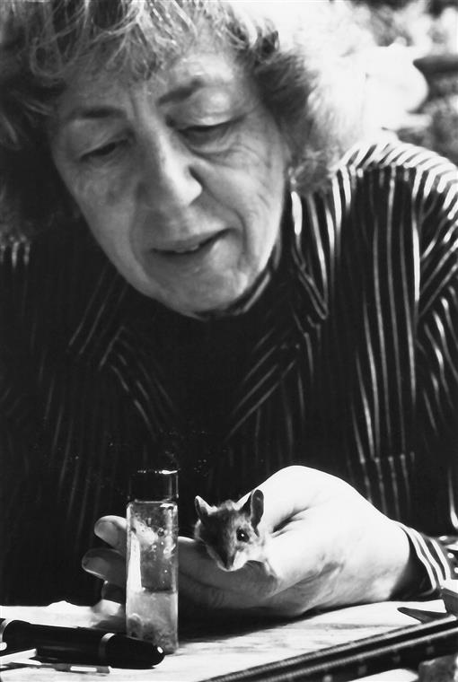
Elizabeth Horner Award
Tatiana Velásquez-Roa,
Texas State University
Timekeepers of the forest: How mammalian carnivores navigate fragmented landscapes in Colombia

Slide 23
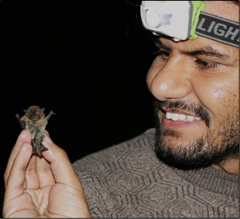
Albert R. and Alma Shadle Fellowship
Basant Sharma,
Kansas State University
Biogeography of Himalayan mammals: Evolutionary and phylogeographic insights from bats

Slide 24
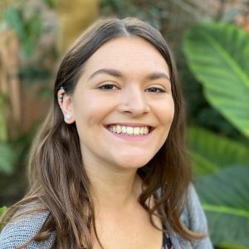
ASM Fellowship
Olivia Chapman,
University of North Carolina at Greensboro
Macroscopic and Microstructural Plasticity of the Gastrointestinal Tract in Mammalia

Slide 25
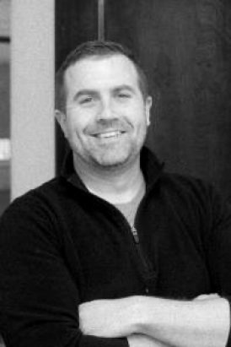
2026 Hartley T. Jackson Award
Cody Thompson
Hartley Jackson and Vernon Bailey, 1935

Slide 26
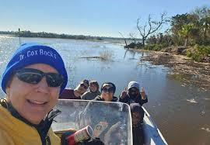
2026 Joseph Grinnell Award
Tara Cox

Slide 27
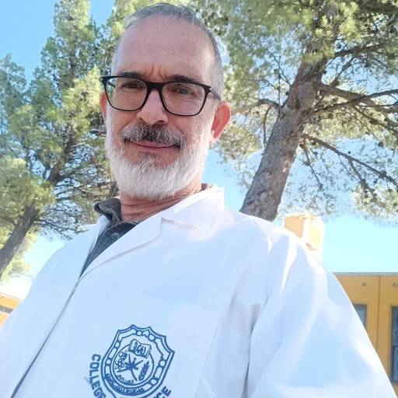
2026 C.H. Merriam Award
Ulyses F. J. Pardiñas

